Slide 1

Correlation of Clinical Factors with Heart Failure Mortality TEAM MEMBERS: - PRATHIMA BURRI RATHNAKAR RAJANALA ROSHINI AMULLA SABA AMREEN MOHAMMAD SAI KUMAR CHARY SRIPATHI

Slide 2
Introduction
Research aim: Identify the correlation between various clinical factors (age, anemia, high blood pressure, CPK levels, diabetes, ejection fraction, platelet count, sex, serum creatinine, serum sodium, smoking status, follow-up period) and mortality in heart failure patients
Significance:
Heart failure affects millions globally
High mortality rate, major public health concern
Identify high-risk heart failure patients
Examine factor-mortality relationships
Guide therapy based on findings
Potential Impact:
Better understanding of risk factors
Targeted monitoring and treatment
Improved patient outcomes

Slide 3
Data Set Description
Source: Faisalabad Institute of Cardiology and the Allied Hospital in Faisalabad, Pakistan299 heart failure patients (105 women, 194 men), ages 40-95All had left ventricular systolic dysfunction and previous heart failures in NYHA classes III or IV
Dependent Variable: Death event (binary)
Independent Variables: Age, anemia, high blood pressure, CPK levels, diabetes, ejection fraction, platelet count, sex, serum creatinine, serum sodium, smoking status, follow-up period
Dataset Link: https://www.kaggle.com/datasets/nimapourmoradi/heart-failure-clinical-records

Slide 4
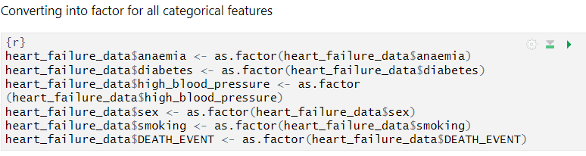
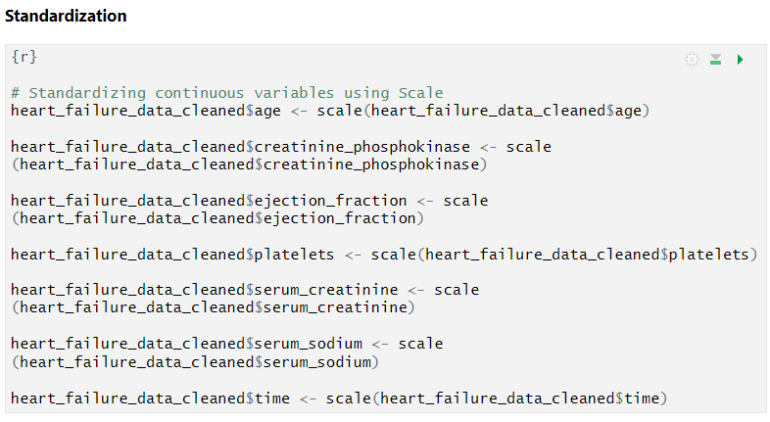
Data Preprocessing Steps
Converting categorical variables to factors
Check form Missing Values – No missing values found
Standardization of continuous variables

Slide 5
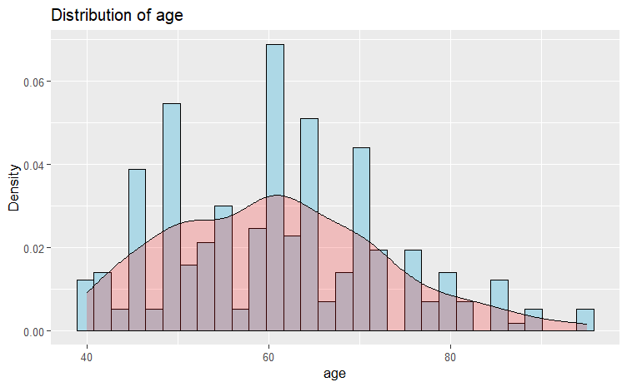
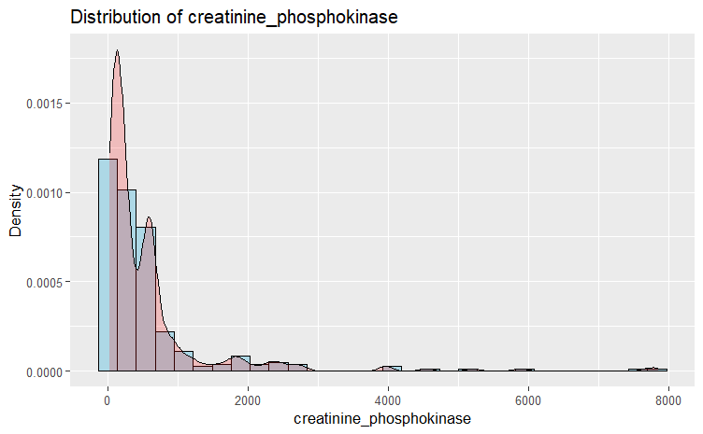
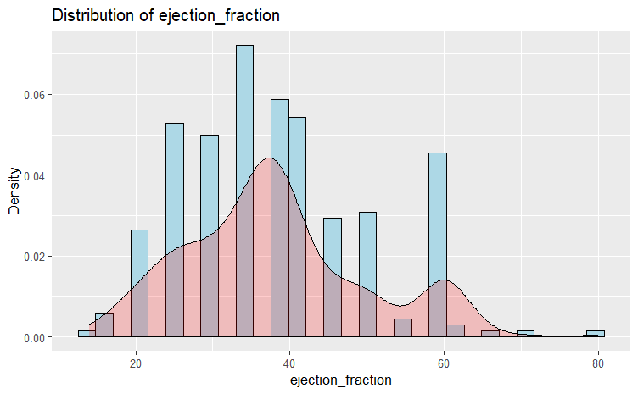
EDA - Distribution Plots
Age: Symmetric distribution, median 60 years, interquartile range 51-70 years
CPK levels: Right-skewed distribution, median 250, mean 581.8
Ejection fraction: Symmetric distribution, median 38%, interquartile range 30-45%

Slide 6
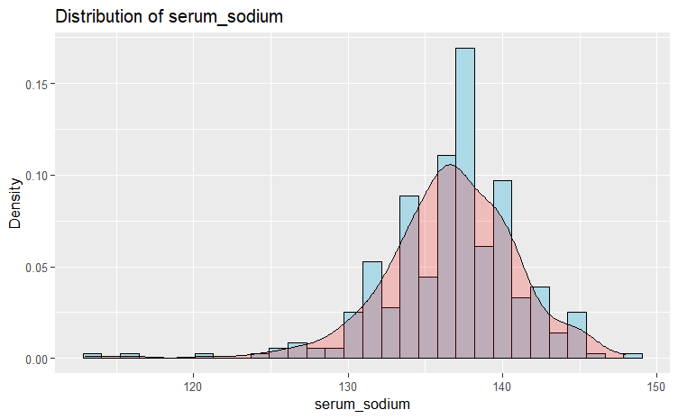
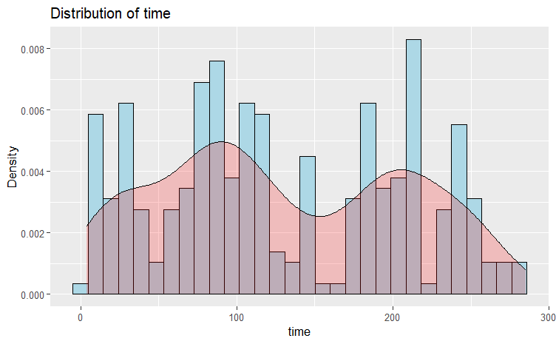
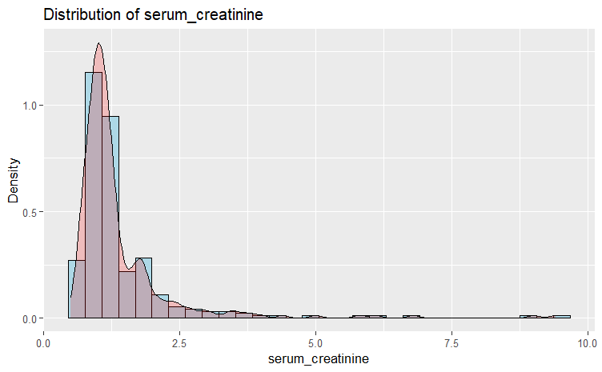
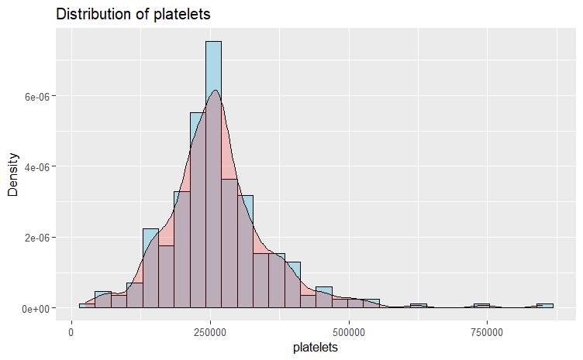
EDA - Distribution Plots
Serum creatinine, platelets, follow-up time: Right-skewed distributions
Serum sodium: Approximately symmetric distribution
Platelets: Median 262,000, mean 263,358, right-skewed
Time: Median 115 days, mean 130.3 days, right-skewed

Slide 7
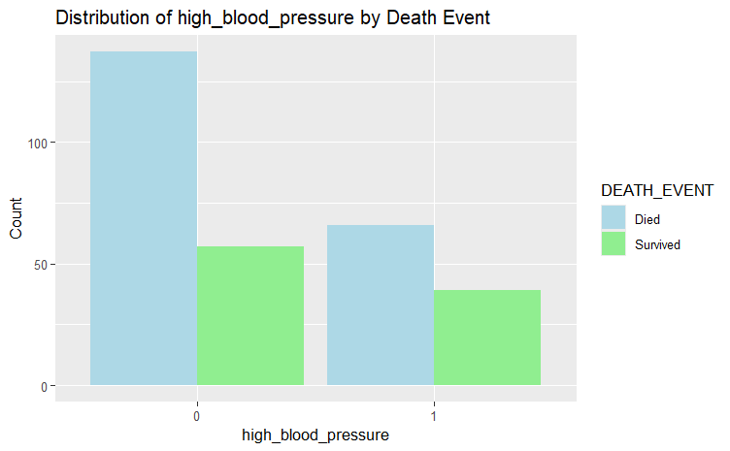
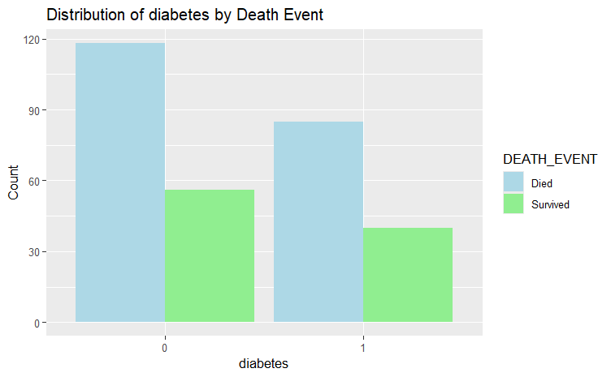
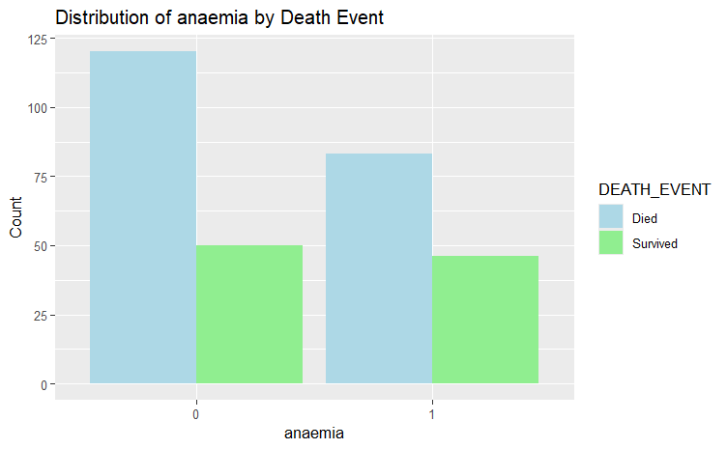
EDA - Categorical Variables
• Anemia: Lower survival rate (64.34%) compared to non-anemic patients (70.59%), associated with increased death risk
• Diabetes: Survival rates comparable between diabetic (68%) and non-diabetic (67.82%) patients, minimal impact on mortality
• High Blood Pressure: Lower survival rate (62.86%) compared to patients without high blood pressure (70.62%), related to increased mortality
Distribution of Categorical Variables by Death Event

Slide 8
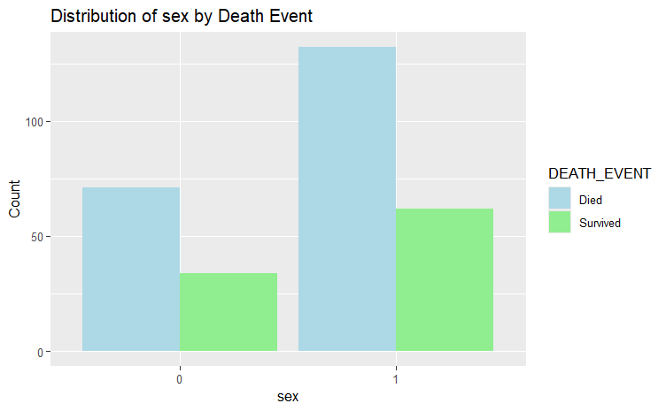
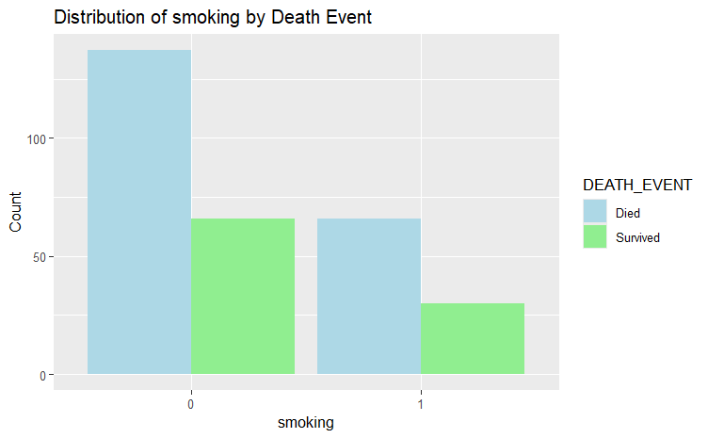
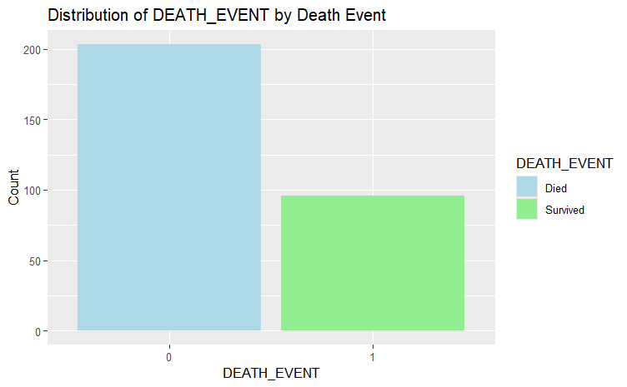
EDA - Categorical Variables
• Sex: Modest difference in survival rates between males (68.04%) and females (67.62%)
• Smoking: Minimal difference in survival rates between smokers (68.75%) and non-smokers (67.49%)
• Dataset imbalance: Majority class is death event
• Key Factors: High Blood Pressure and Anemia are highly affecting patient survival
Distribution of Categorical Variables by Death Event

Slide 9
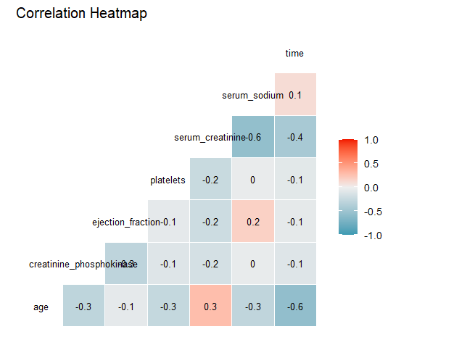
EDA - Correlation
Largely weak relationships between the numerical variables
Largest positive connection between ejection fraction and serum sodium (0.18)
Strongest negative correlation between age and time (-0.22).

Slide 10
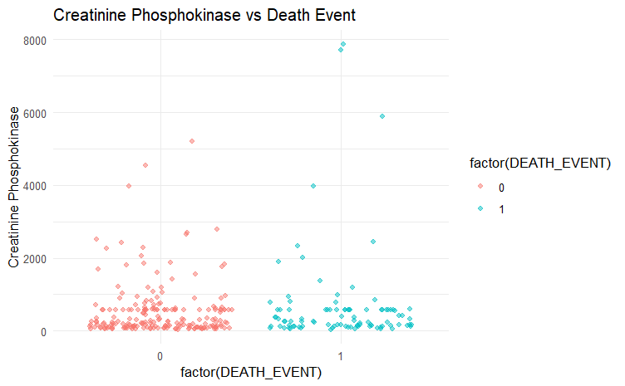
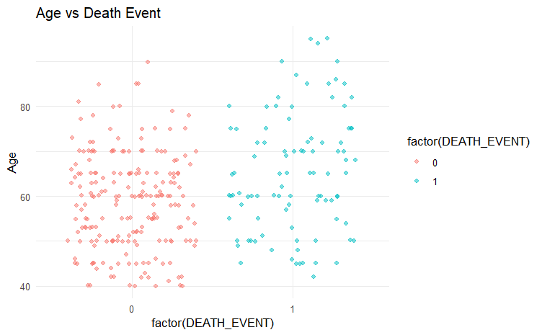
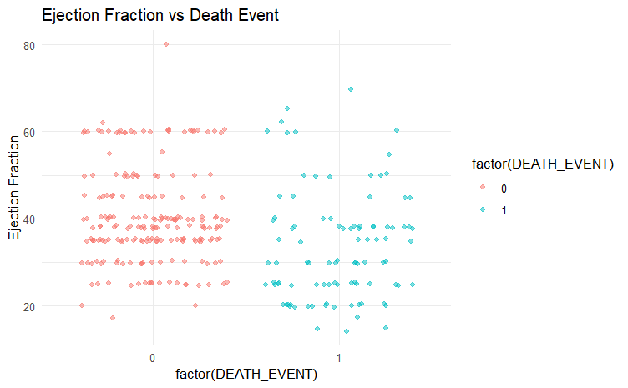
EDA – Scatter Plots
No significant difference has been found in the features with respect to the death event.

Slide 11
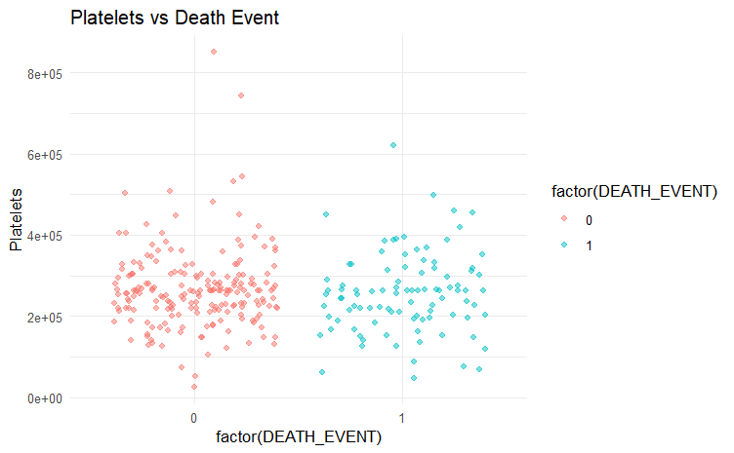
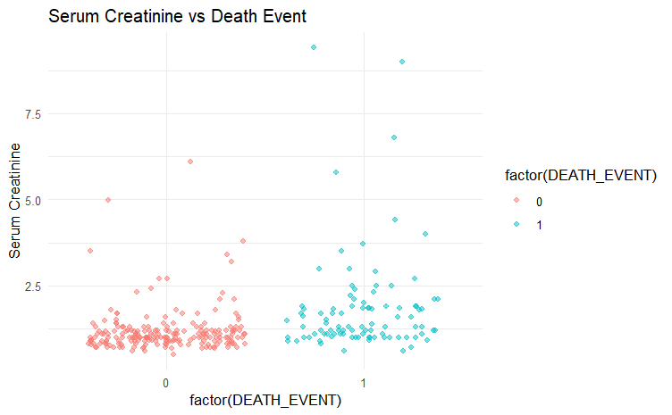
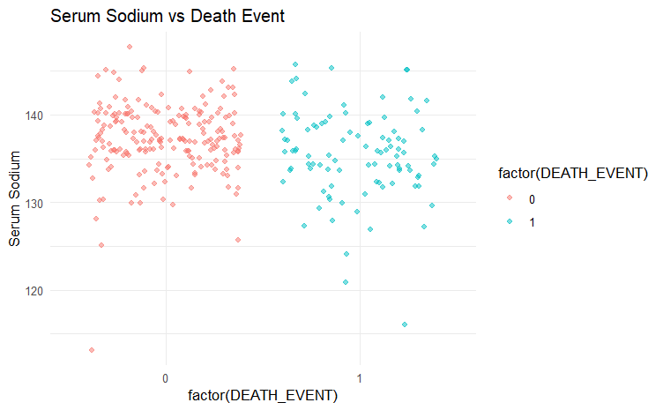
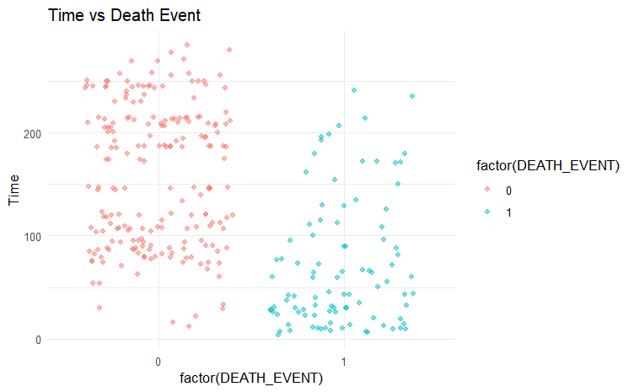
EDA – Scatter Plots
No significant difference has been found in the features with respect to the death event.
When comparing time distribution with respect to death event, the death patients has tendency to have time below 0 and survival patients has higher time when compared.

Slide 12


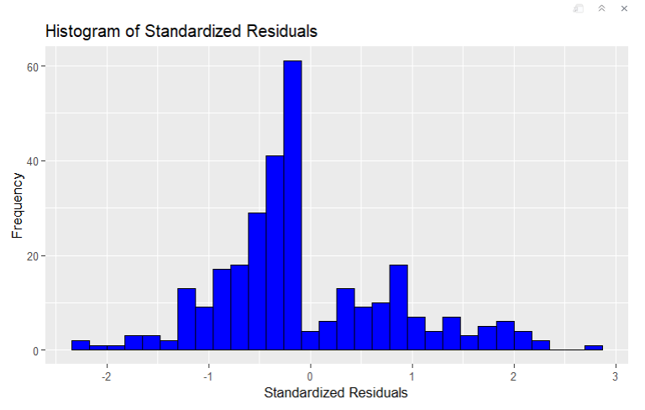
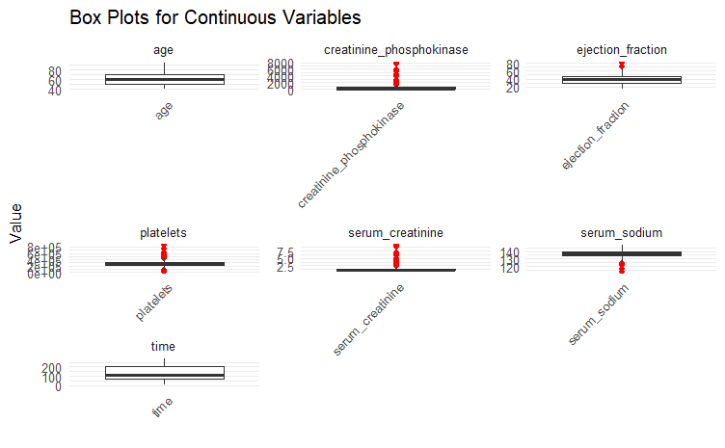
Outliers Detection using Standard Residuals
Handled outliers using standardized residuals
Filtered out observations with |standardized residual| > 1.96
Created a cleaned dataset by removing outliers

Slide 13
Statistical Tests - Categorical Variables
Chi-Square and Fishers Test for Categorical Variables
Variable Name | P-value | Result
Anemia (Chi Square) | 0.4042 | No significant link with death event
High Blood Pressure (Chi Square) | 0.1077 | No significant link with death event
Diabetes (Chi Square) | 1.0000 | No significant link with death event
Sex (Fisher’s) | 1 | No significant link with death event
Smoking Status (Fisher’s) | 1.0000 | No significant link with death event
Findings
The chi-square tests did not find a statistically significant association between anemia, high blood pressure, diabetes, sex, and smoking status with the death event in this dataset.
Diabetes, sex and smoking status has p-values of 1 indicates no relation with death.

Slide 14
Logistic Regression Test for Continuous Variables
Feature Name | P value | Result
Age | 8.92e-06 | Significant difference found
Creatinine Phosphokinase | 0.684 | No significant difference found
Ejection Fraction | 2.45e-06 | Significant difference found
Platelets | 0.426 | No significant difference found
Serum Creatinine | 1.58e-10 | Significant difference found
Serum Sodium | 0.00069 | Significant difference found
Time | 6.85e-21 | Significant difference found
Key Findings: Age, Ejection Fraction, Serum Creatinine, Serum Sodium, Follow-up Time are potentially important predictors of mortality in heart failure patients.

Slide 15
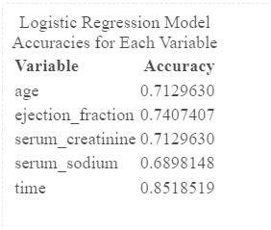
Logistic Regression Model with One Variable
X = [age or ejection_fraction or serum_creatinine or serum_sodium or time] and Y = Death_Event
Splitting Data into Train and Test Data 75% Training Data and 25% Test Data
Train the model using Train Data
Time is the best predictor

Slide 16
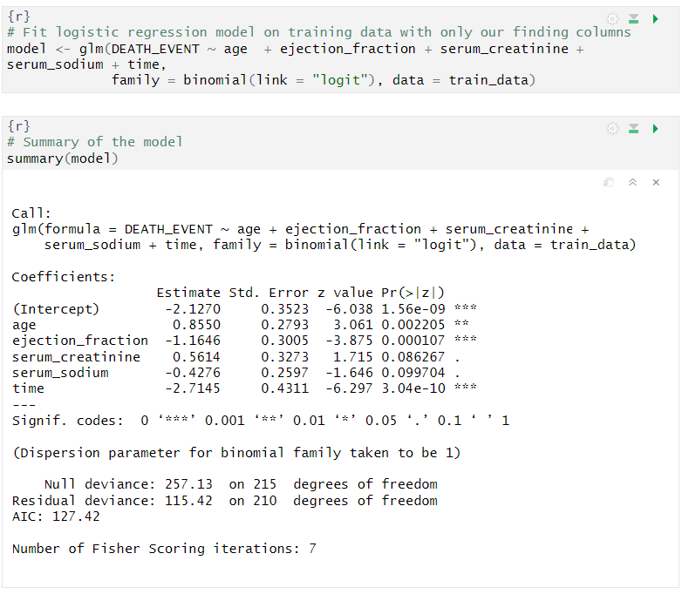
Logistic Regression Model
X = [age + ejection_fraction + serum_creatinine + serum_sodium + time] and Y = Death_Event
Splitting Data into Train and Test Data 75% Training Data and 25% Test Data
Train the model using Train Data

Slide 17
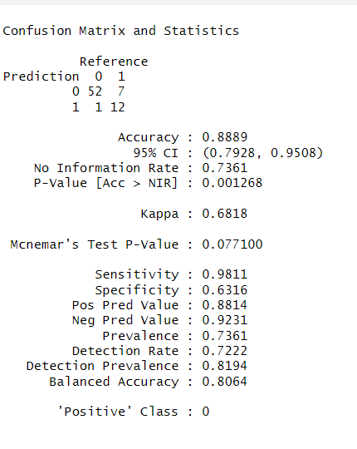
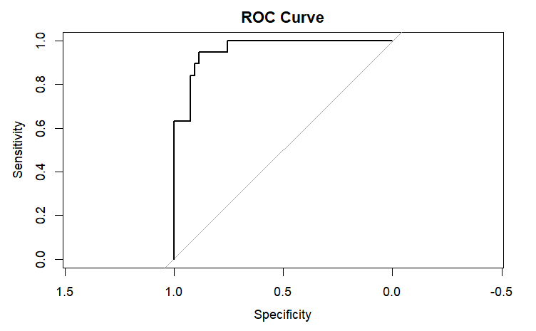
Performance Metrics
AUC ROC Curve - trade-off between the true positive rate (TPR) and the false positive rate (FPR) for different probability thresholds.
Test Accuracy Achieved: 88.89%

Slide 18

Conclusions
Age, ejection fraction, serum creatinine, serum sodium, and follow-up period (time) emerged as significant predictors of mortality, indicating a strong correlation between these factors and mortality in heart failure patients
These findings highlight the importance of considering these clinical factors, particularly age, ejection fraction, serum creatinine, serum sodium, and follow-up period, in assessing mortality risk and developing predictive models for heart failure patients.
Key predictors: Age, ejection fraction, serum creatinine, serum sodium, and follow-up period are identified as significant predictors of mortality in heart failure patients.

